Slide 1

DynamoDB operations from VSCode & accessing DynamoDB tables using nginx
Ankita Phadke
04/20/23

Slide 2
DynamoDB operations from VSCode (without logging into EC2, directly from local VSCode)
Part 1: Do create, insert, query, create global secondary index, query global secondary for a dynamodb using python scripts (just like we did in demo in class) in your laptop using VS Code

Slide 3
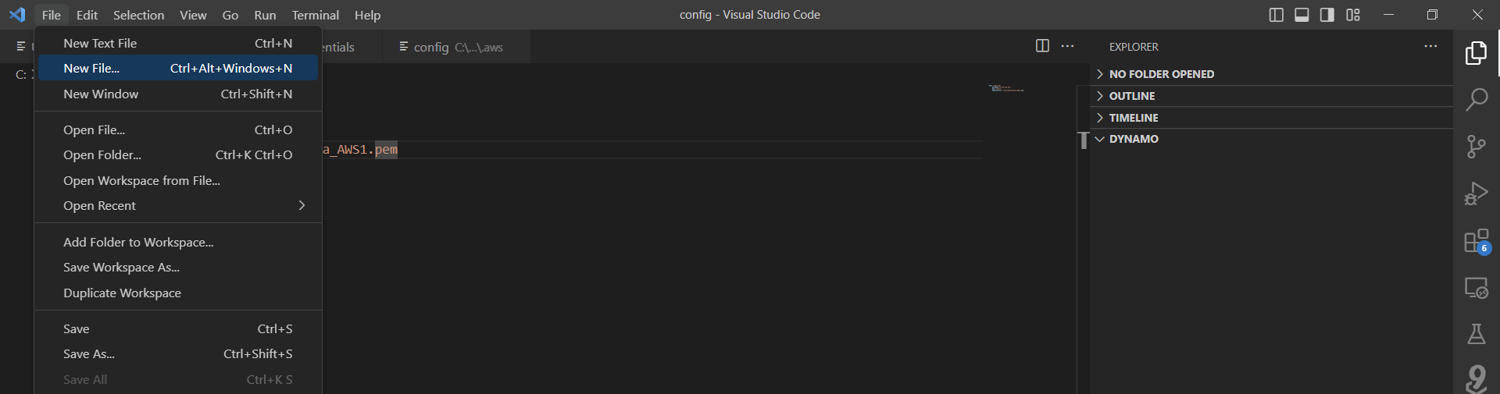
Accessing DynamoDB from EC2
AWS IAM user is already logged in to VSCode.
Click on File > New File to create a new Python file
(This is done directly on local copy of VSCode, essentially on the laptop)
Inside VSCode

Slide 4
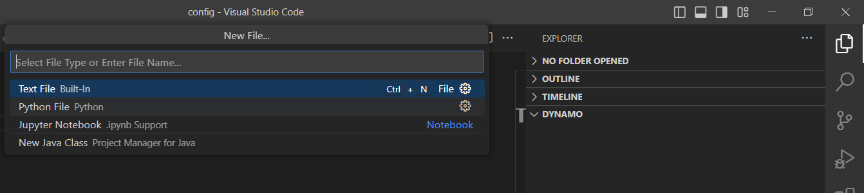
Accessing DynamoDB from EC2
Select the option ‘Python File’ from the drop down.
Inside VSCode

Slide 5
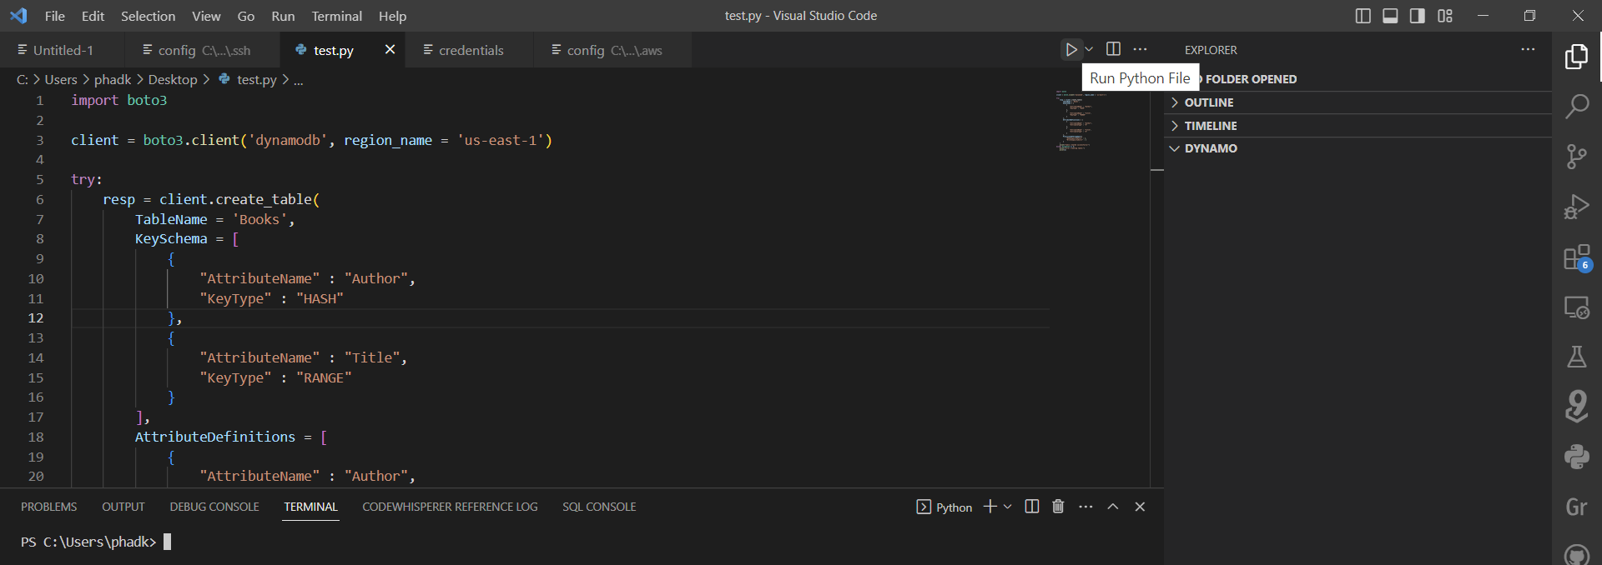
Accessing DynamoDB from EC2
Write code to create new DynamoDB table named: ‘Books’ and run the file
Inside VSCode

Slide 6
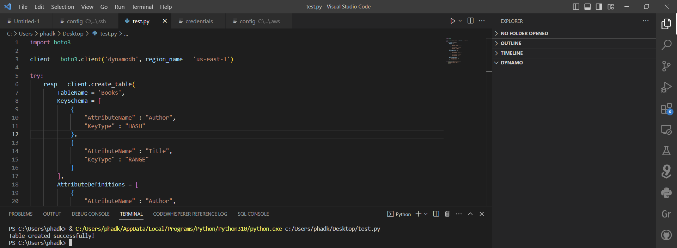
Accessing DynamoDB from EC2
Table gets created successfully
Inside VSCode

Slide 7
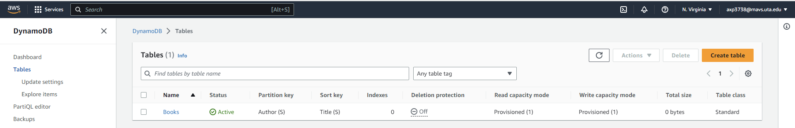
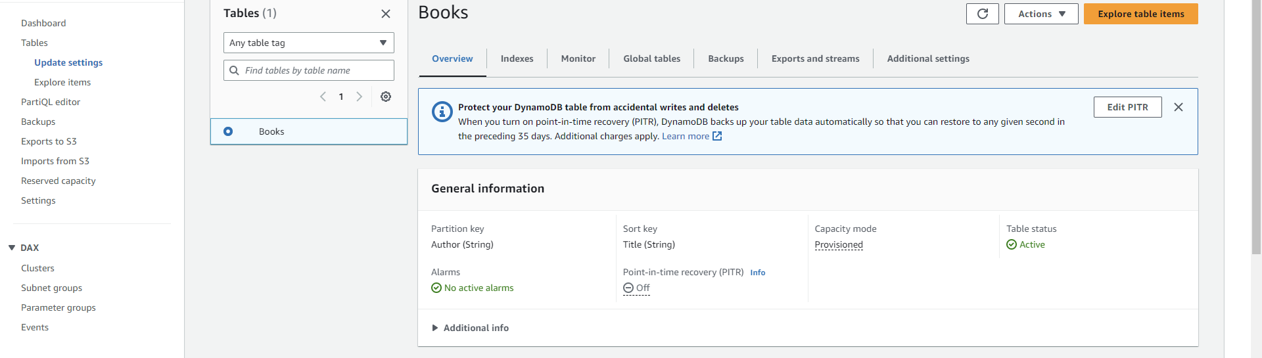
Accessing DynamoDB from EC2
Verify if table is successfully created inside AWS
Inside AWS

Slide 8
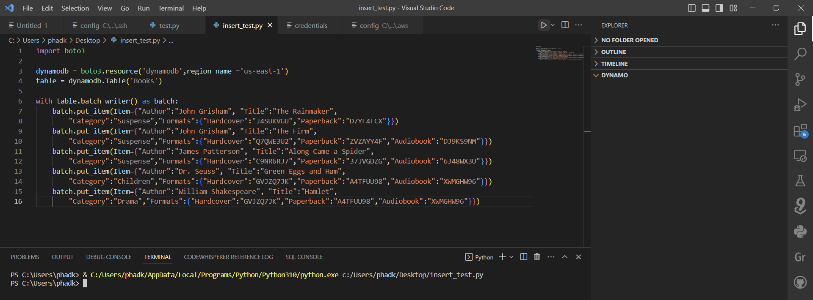
Accessing DynamoDB from EC2
Insert data into the table using another Python code, and run the file
Inside VSCode

Slide 9
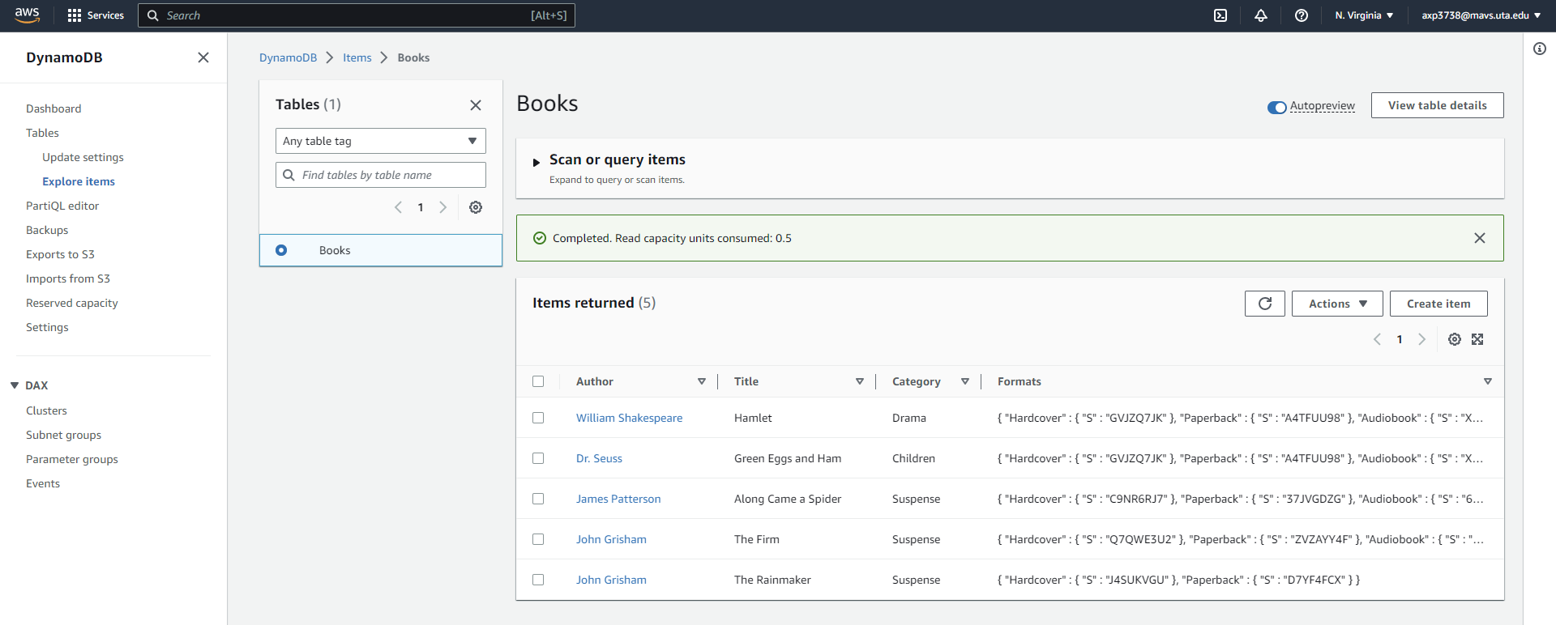
Accessing DynamoDB from EC2
Verify that records are successfully created inside AWS
Inside AWS

Slide 10
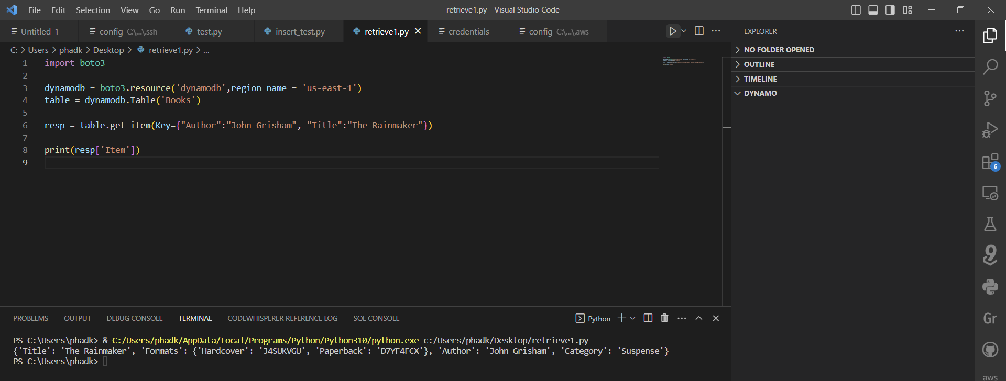
Accessing DynamoDB from EC2
Write and test python to code to retrieve data from DynamoDB table.
Output is shown on the terminal
Inside VSCode

Slide 11
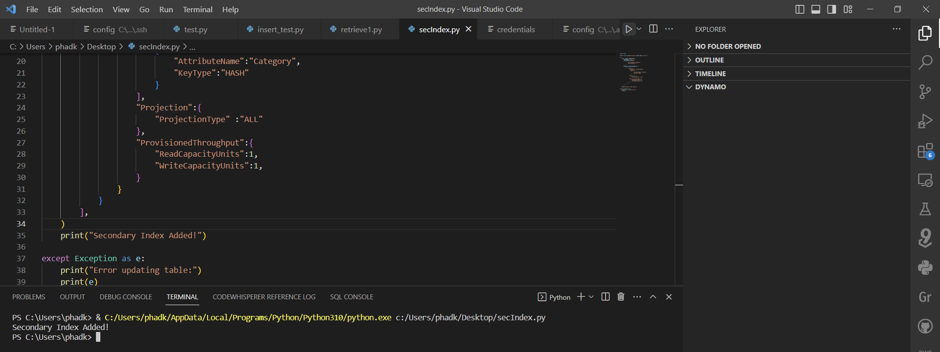
Accessing DynamoDB from EC2
Create Python code to create secondary index and run the file
Inside VSCode

Slide 12
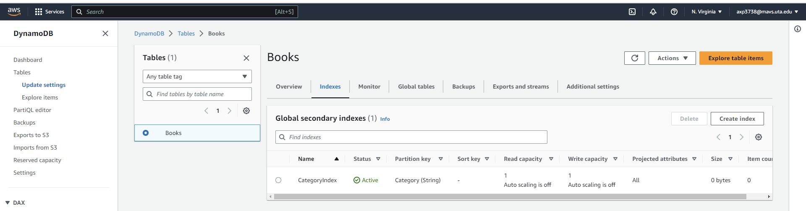
Accessing DynamoDB from EC2
Verified the creation of secondary index in AWS
Inside AWS

Slide 13
Accessing DynamoDB table using nginx on EC2
Part 2: After that, install nginx in an EC2 and edit the html file so it can query the dynamodb you created in item 1. Call it from a browser to query an item in the DynamoDB

Slide 14
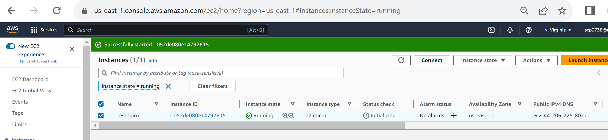
Accessing DynamoDB from nginx
Power on the EC2, connect to EC2 using AWS Connect option
Inside AWS

Slide 15
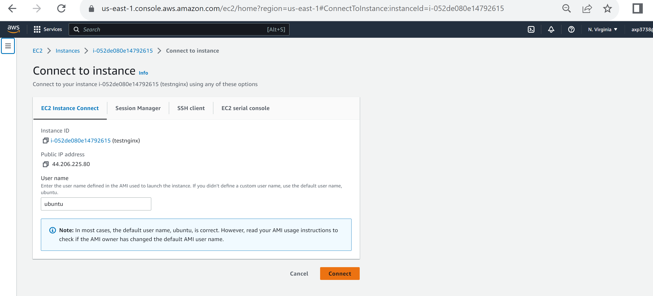
Accessing DynamoDB from nginx
Connect to EC2 using AWS ‘Connect to Instance’ option
Inside AWS

Slide 16
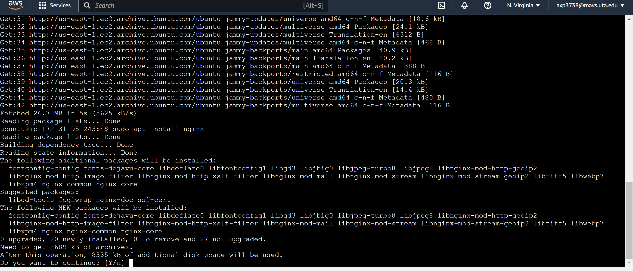
Accessing DynamoDB from nginx
Install nginx on EC2 using below ubuntu command
Inside AWS

Slide 17
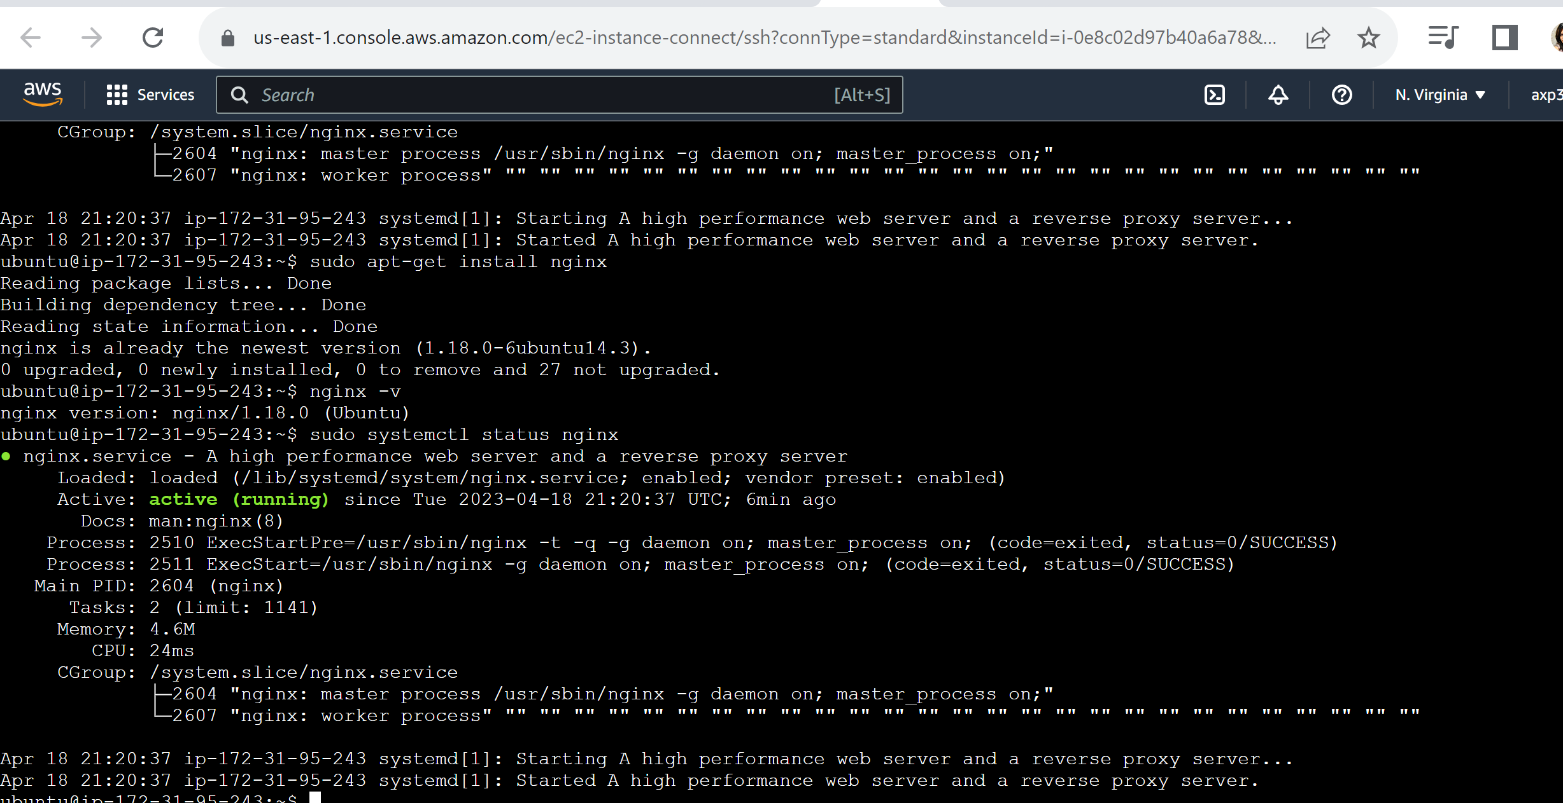
Accessing DynamoDB from nginx
Verify that nginx is running successfully
Inside AWS

Slide 18
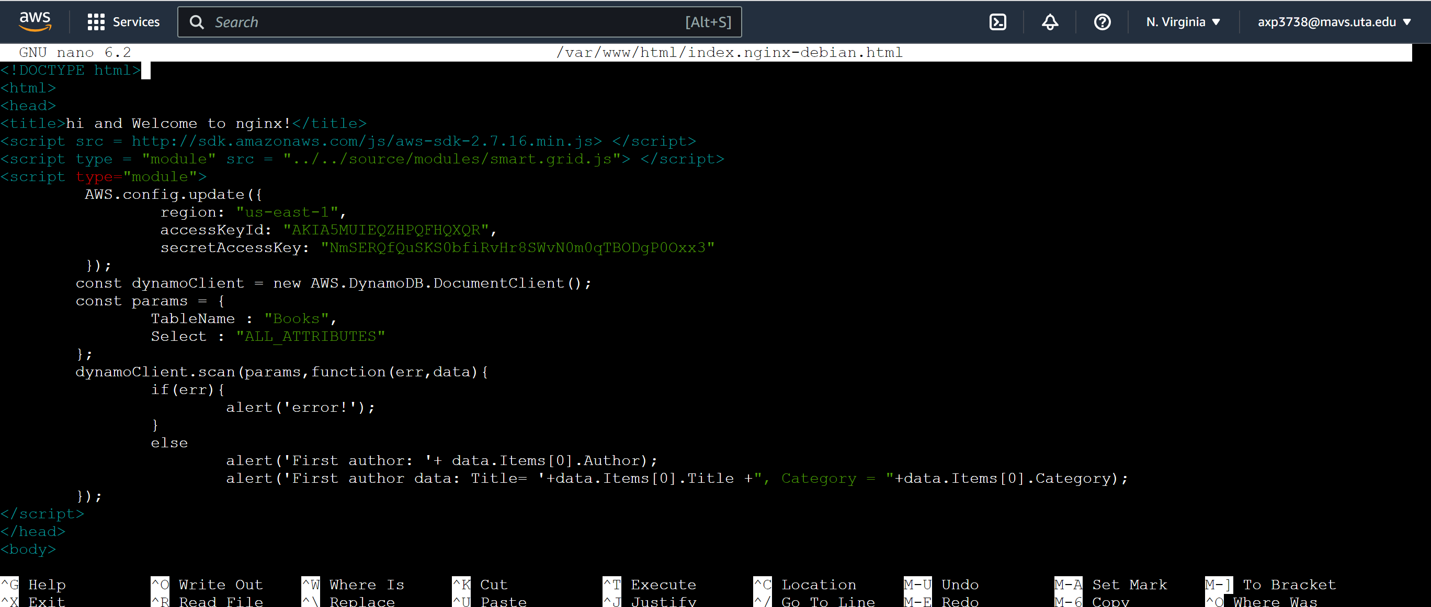
Enter a test code to connect to DynamoDB
Inside AWS

Slide 19
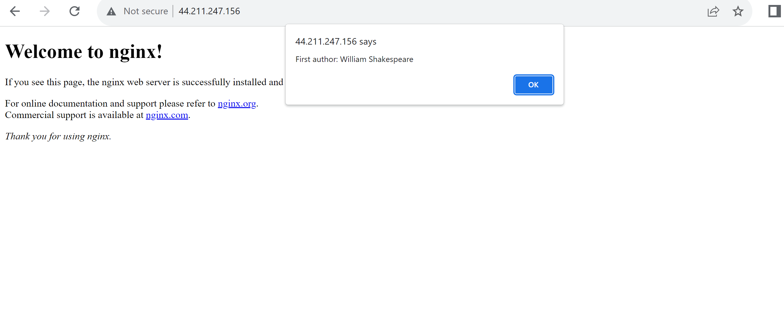
Browser shows the output of DynamoDB scan
On browser

Slide 20
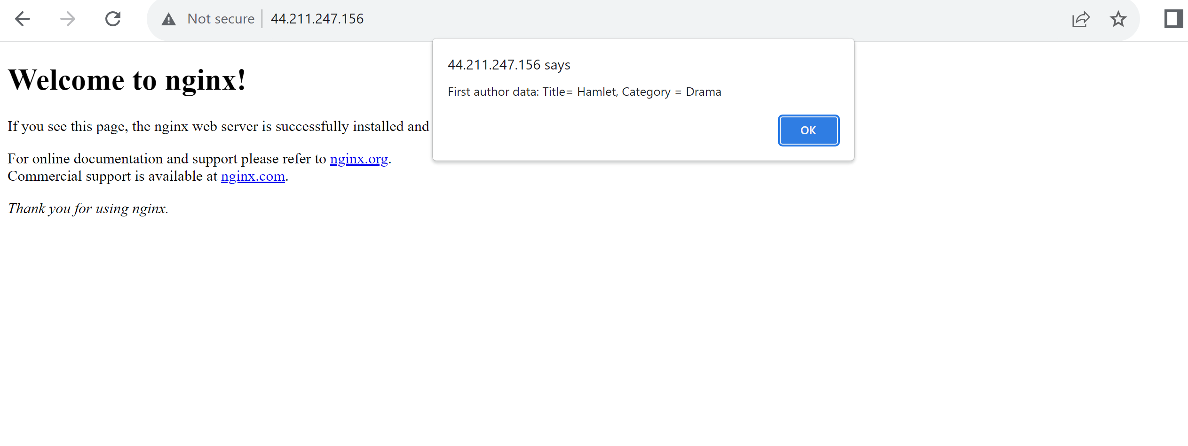
Browser shows the output of DynamoDB scan
On browser

Slide 21
References:
https://www.htmlelements.com/docs/grid-with-dynamodb/
https://www.youtube.com/watch?v=PuuWRfCa668
https://www.youtube.com/watch?v=a9hvw701GOI

